Slide 1
FLOOD ALERT SYSTEM
Using a zigbee SENSOR NETWORk
ITMT 492 – Embedded Systems
Israel Aires
Luiz Pinto
Alysson Souza

Slide 2
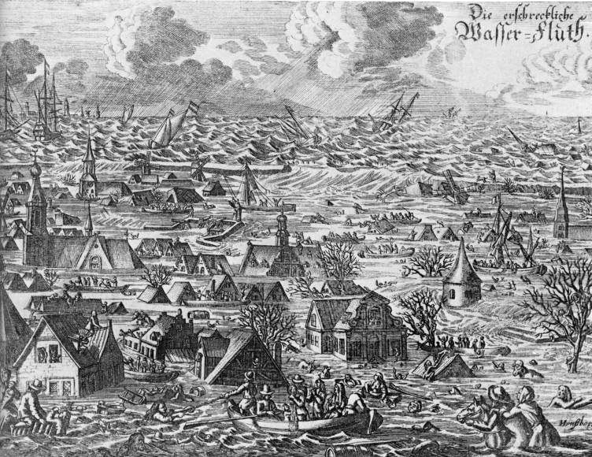
Context
A flood is a general and temporary condition where two or more acres of normally dry land are inundated by water or mudflow.

Slide 3
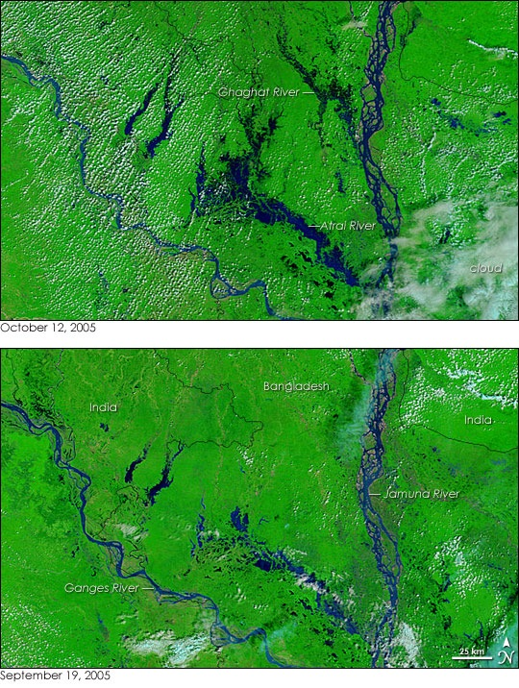
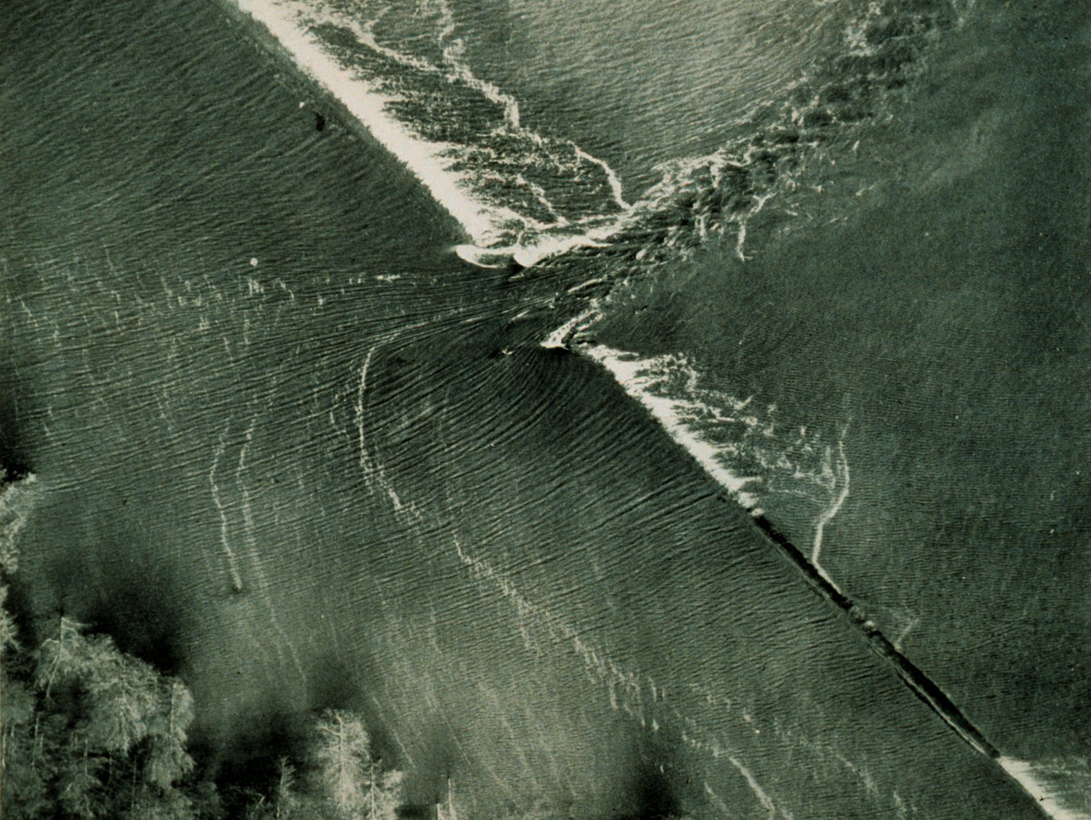
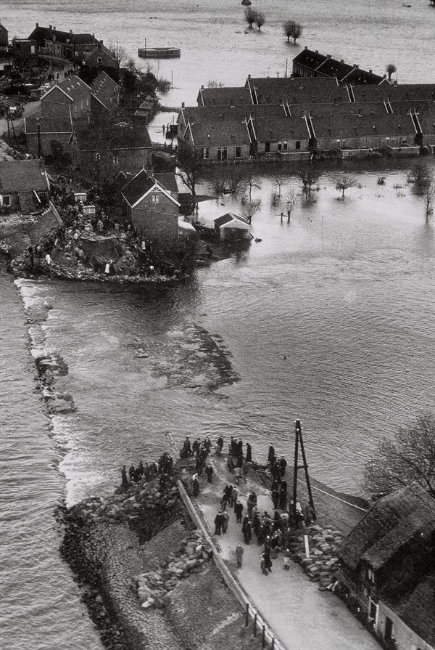
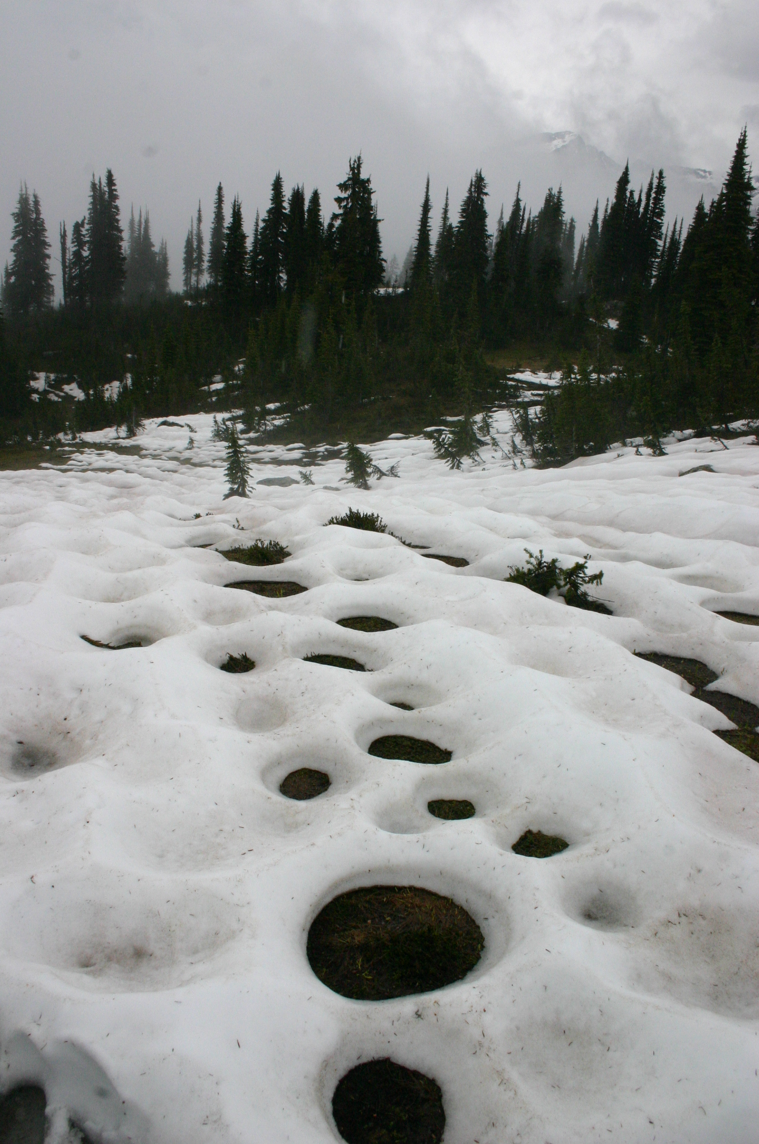
Context
Causes: overtopped levees, outdated or clogged drainage systems, rapid accumulation of rainfall, snowmelt and river overflow.

Slide 4
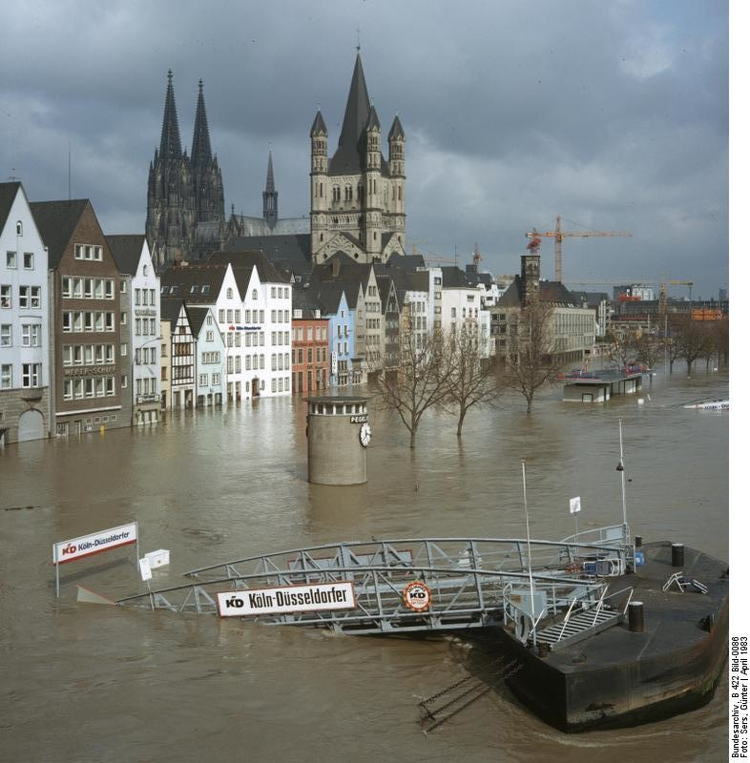
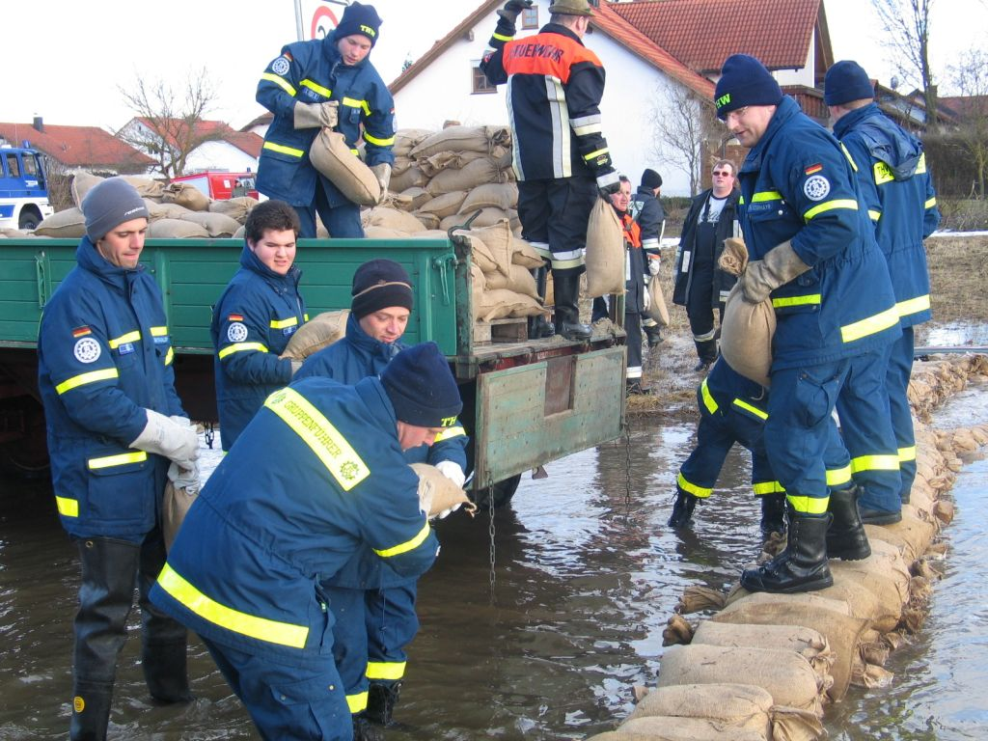
Context
Just a few inches of water from a flood can cause tens of thousands of dollars in damage.

Slide 5
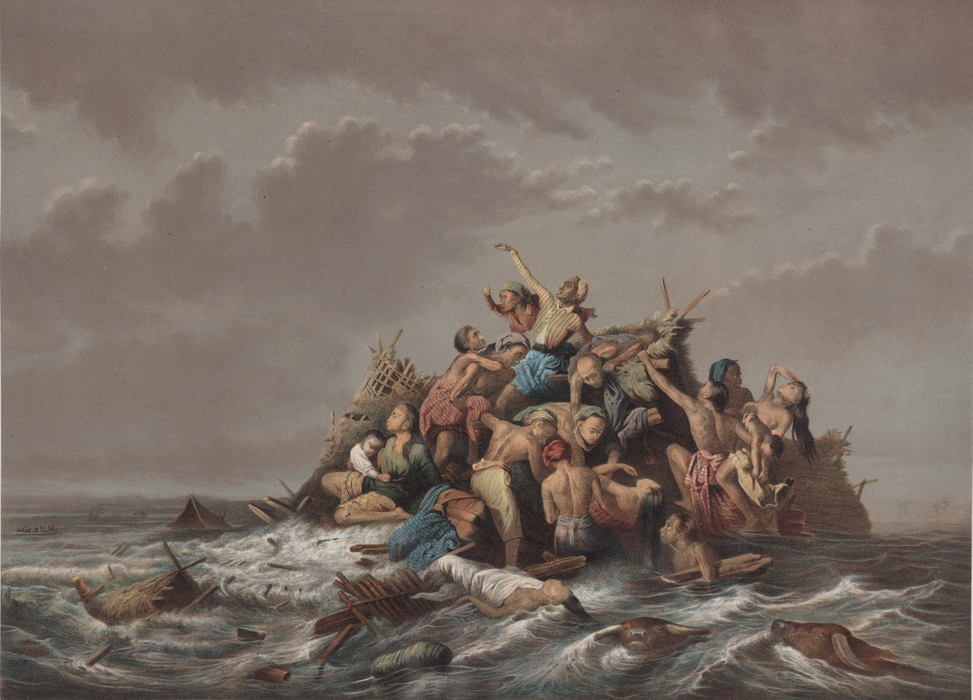
Context
Flash flooding is the leading cause of weather-related deaths in the U.S.- approximately 99 deaths per year (National Weather Service, 2006).

Slide 6
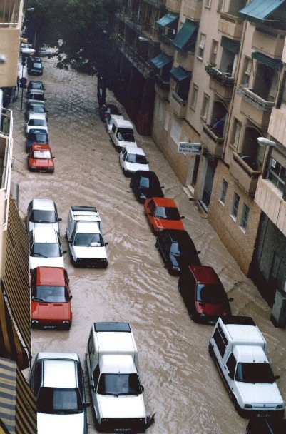
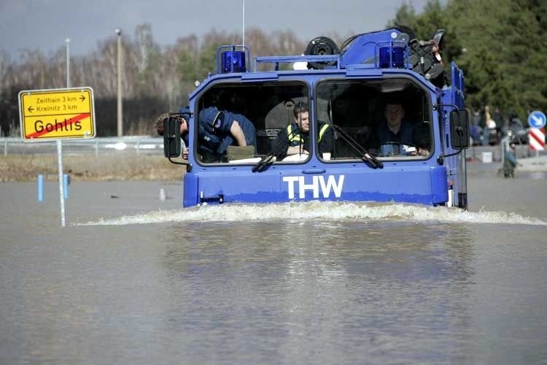
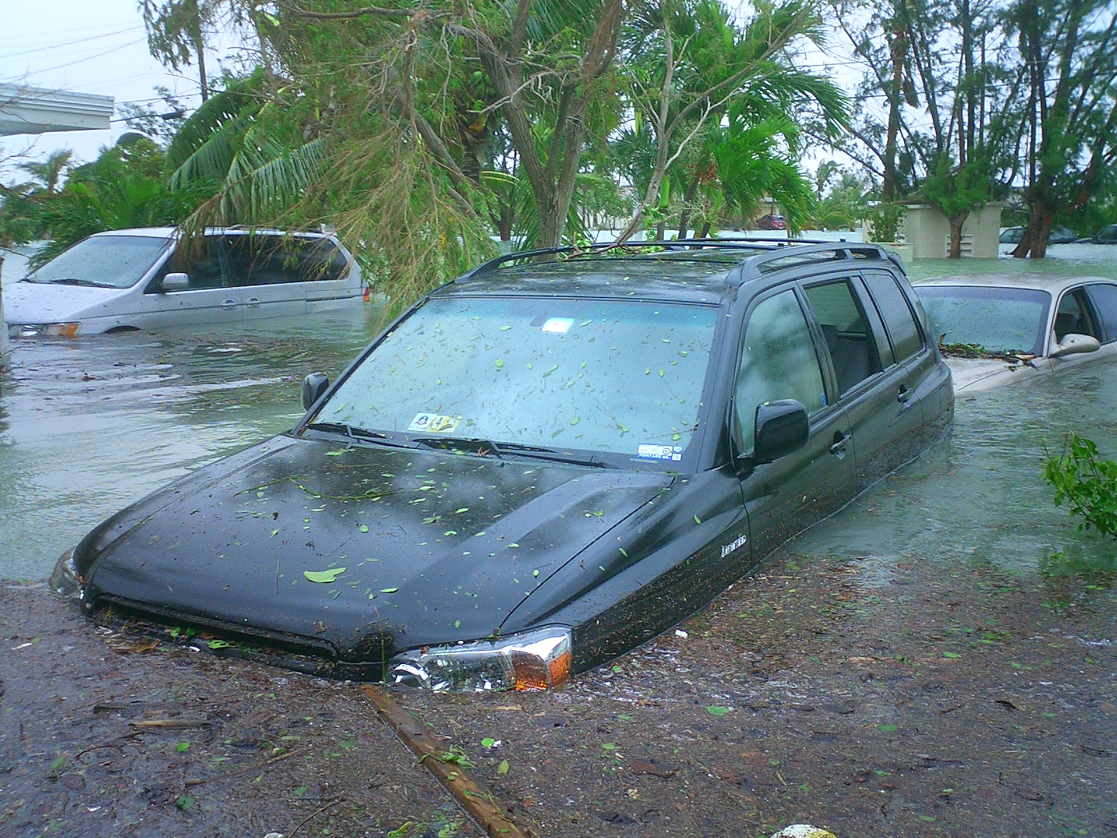
Context
Over 50% of flood-related drownings are vehicle-related.

Slide 7
PURPOSE
Build a simple flood alert system, composed of a mesh sensor network.
The system will monitor water level and present the data in a central.
The goal is to minimize economic damage and help authorities take action in advance of a flash flood.
Analyze the data and point out which areas need more attention.

Slide 8
SYSTEM OVERVIEW
The flood alert system should be composed by three distinct parts: sensor modules, data central, and a remote server.
Communication between each sensor module and the data central is done via XBee radios.
Communication between the data central and the remote server is done via Internet.
Sensor Modules
Remote Server
Data Central

Slide 9
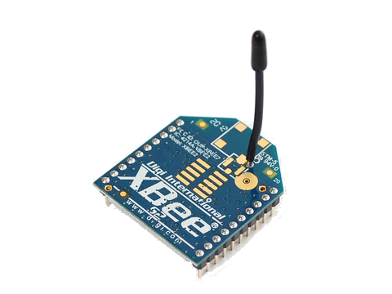
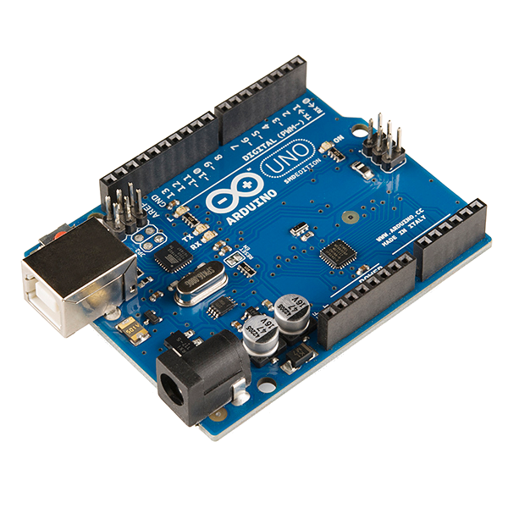
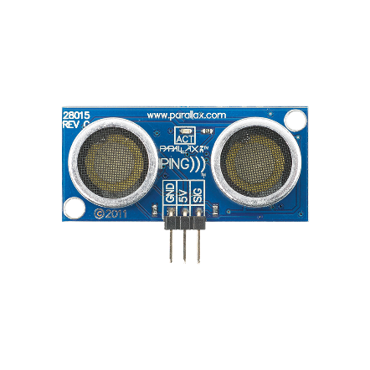
Sensor Modules
Each sensor module is composed by:
An ultrasonic sensor to monitor the water level.
An Arduino Uno microcontroller board.
An XBee radio module to send the data.
Solar panel and battery.

Slide 10
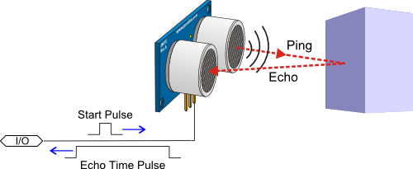
Sensor Modules
How the Ultrasonic Sensor works:
Distance = (Speed Of Sound * Time) / 2
The Distance is divided by 2 to get the distance from the sensor to the object.

Slide 11
Sensor Modules
The Arduino uses the Xbee to send the data hop-by-hop until it reaches the Data Central module.
Each Sensor Module is located along the river with the sensor at the top of the river.
They can be up to 3 kilometers apart from each other.
Sensor Module
3 km
3 km
Data Central
Sensor Module

Slide 12
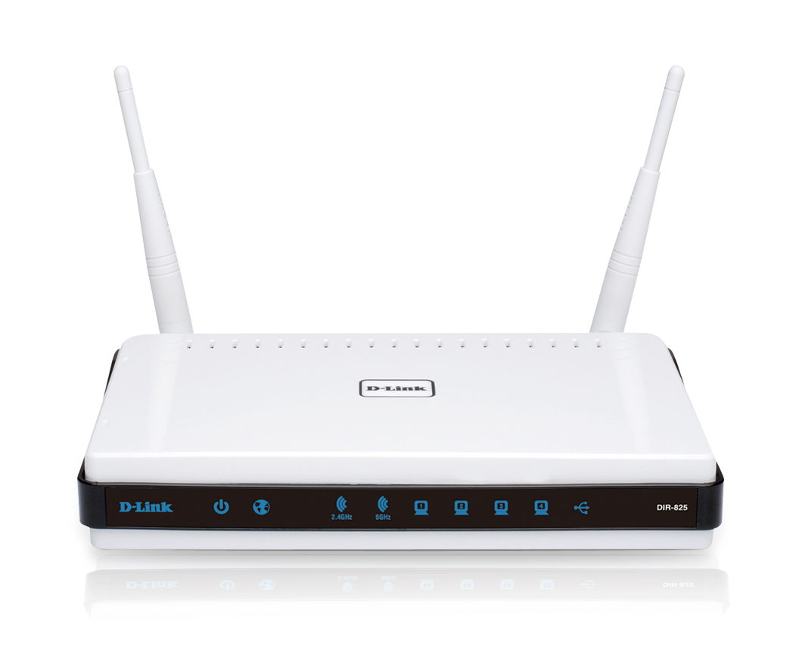
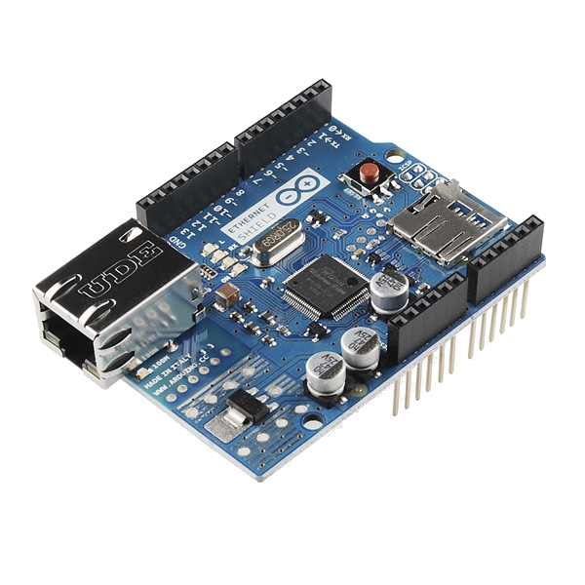
Data central
The data central is secured within a building located near the river.
An XBee radio module is configured as a coordinator, which setup the mesh network.
An Arduino Uno that is connected to an XBee uses an Ethernet shield to connect to a network router.
The XBee is used to receive the data coming from the sensor modules.

Slide 13
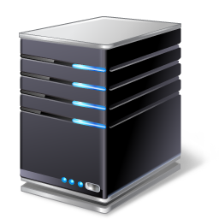
THE REMOTE SERVER
The remote server can be located anywhere in the city, or even elsewhere.
The data received from the Data Central is stored in the server.
The server has an application to analyze historical water level data in a database.
The server is capable of sending alerts via SMS to registered phone numbers.

Slide 14
Summary
 | Functions | Components
Sensor Modules | Monitor the water level. Send the collected data to the next hop from time to time. | Microcontroller Ultrasonic Sensor XBee radio module Battery Solar panel
Data Central Module | Setup the mesh network. Coordinate the frequency that data is sent. Send the data collected to the remote server. | Microcontroller Ethernet shield XBee radio module Router
Remote Server | Store the data received. Process the data and generate charts. Issue alerts via SMS to registered parties. | Router General Packet Radio Service (GPRS) Computer

Slide 15

What comes next
Generate maps showing frequently affected areas;
Add more sensors to the Modules for including more functions;
Develop mobile application to end users.

Slide 16
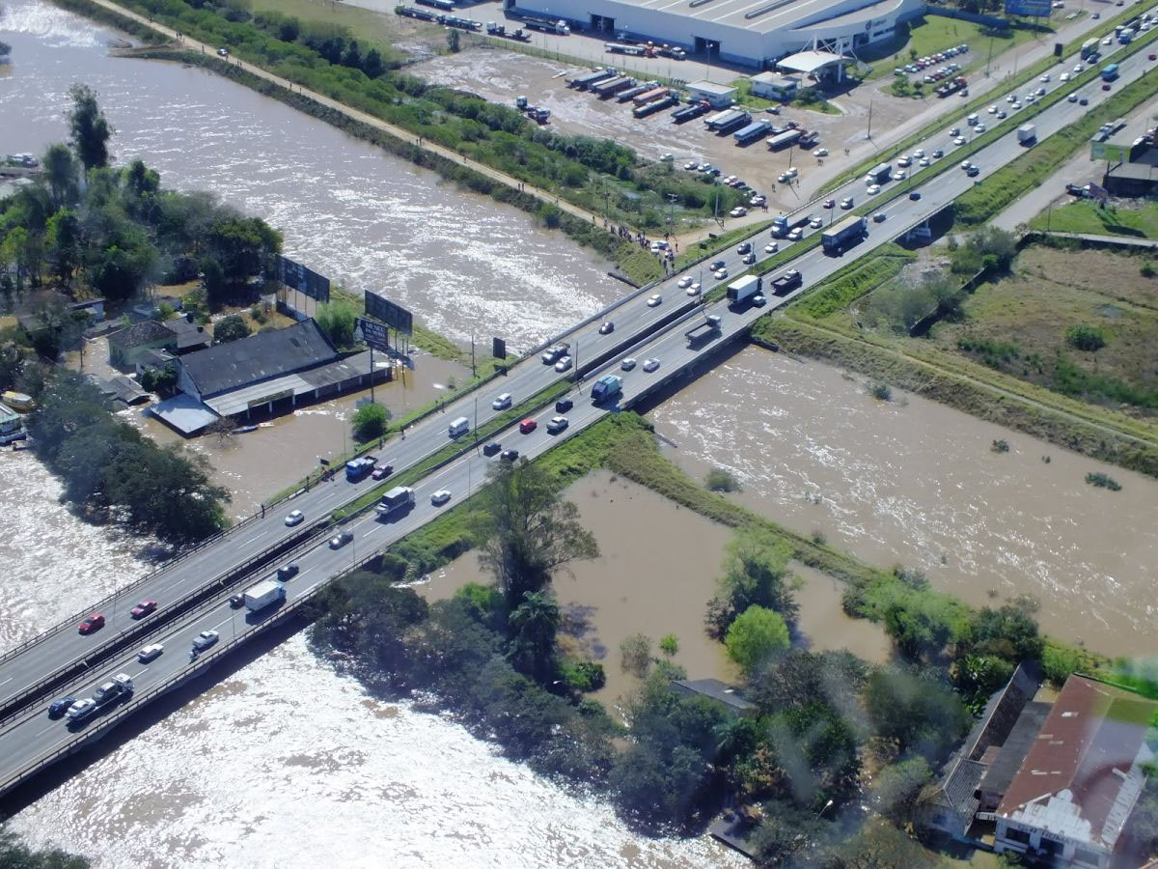
Observations & conclusion
System is relatively simple to implement.
Open source;
Remote server is in planning stage.
Predicting and alerting floods is the first step in taking preventive and/or corrective action.
Hope the system may serve as a basis for future related projects.

Slide 17
Thanks for coming!
Special thanks to Professor Jeremy Hajek and Dr. Daniel Tomal for their help and support in this project.

Slide 18
REFERENCES
http://www.parallax.com/sites/default/files/downloads/28015-PING-Detect-Distance.pdf
http://ftp1.digi.com/support/documentation/90000976_V.pdf

